Slide 1
Project plan, communications plan & risk assessment
Group d

Slide 2
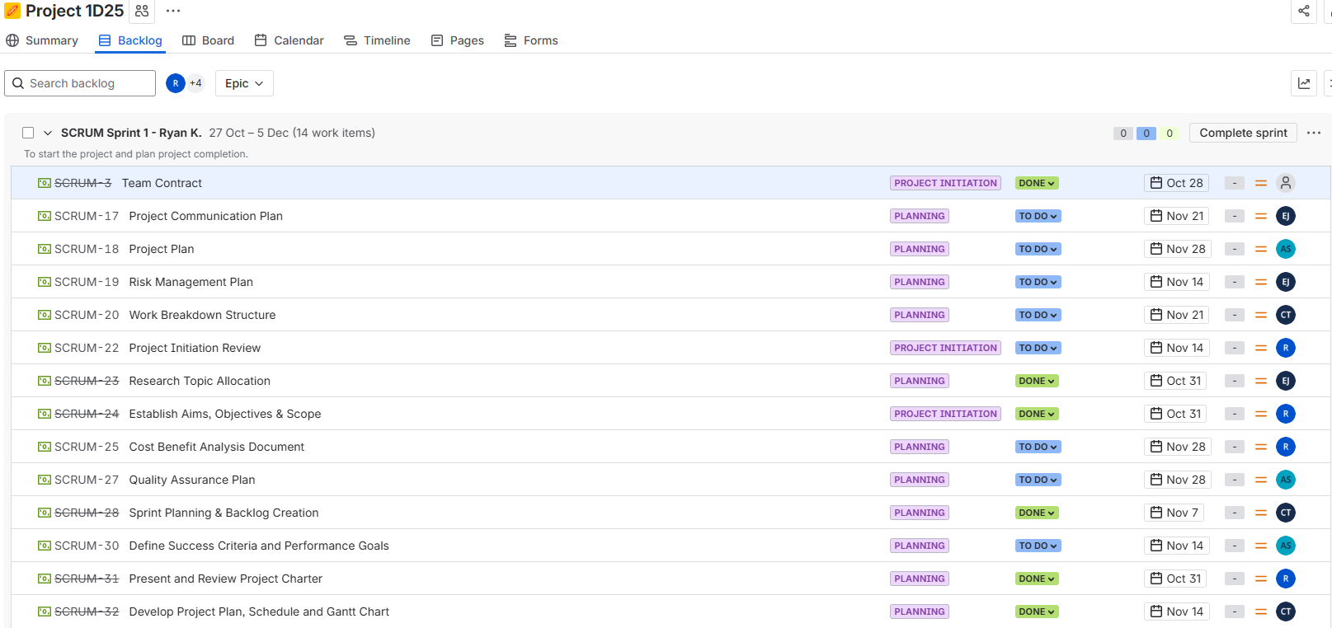
Project plan: Jira

Slide 3
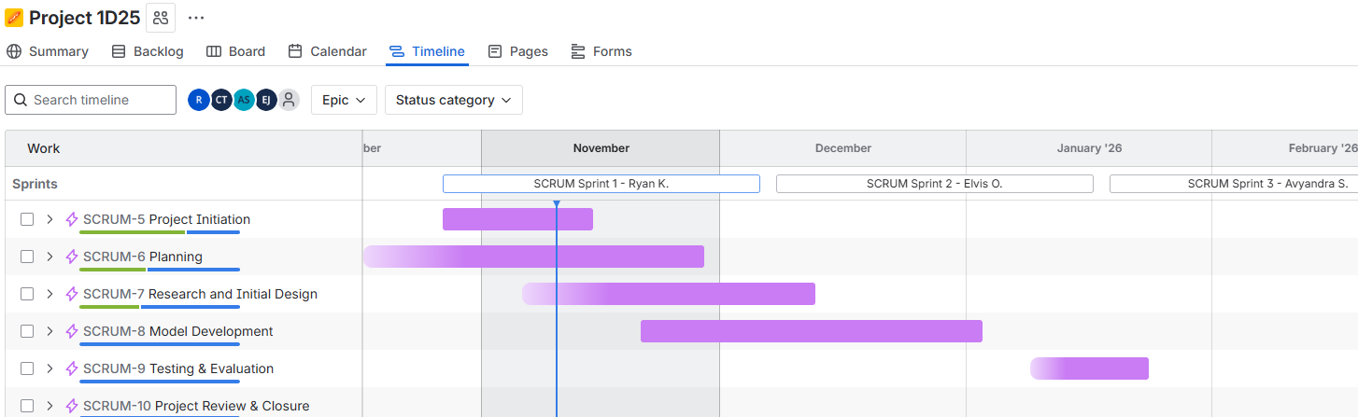
Project timeline Gantt chart

Slide 4
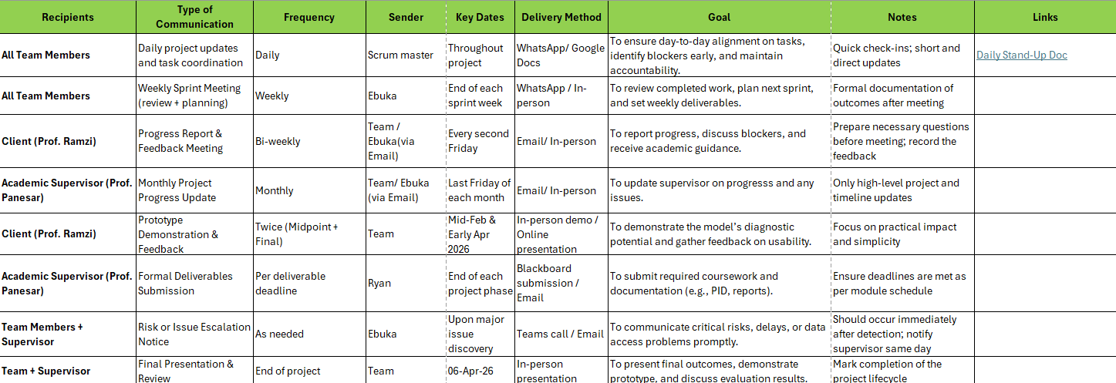
Communications Plan

Slide 5
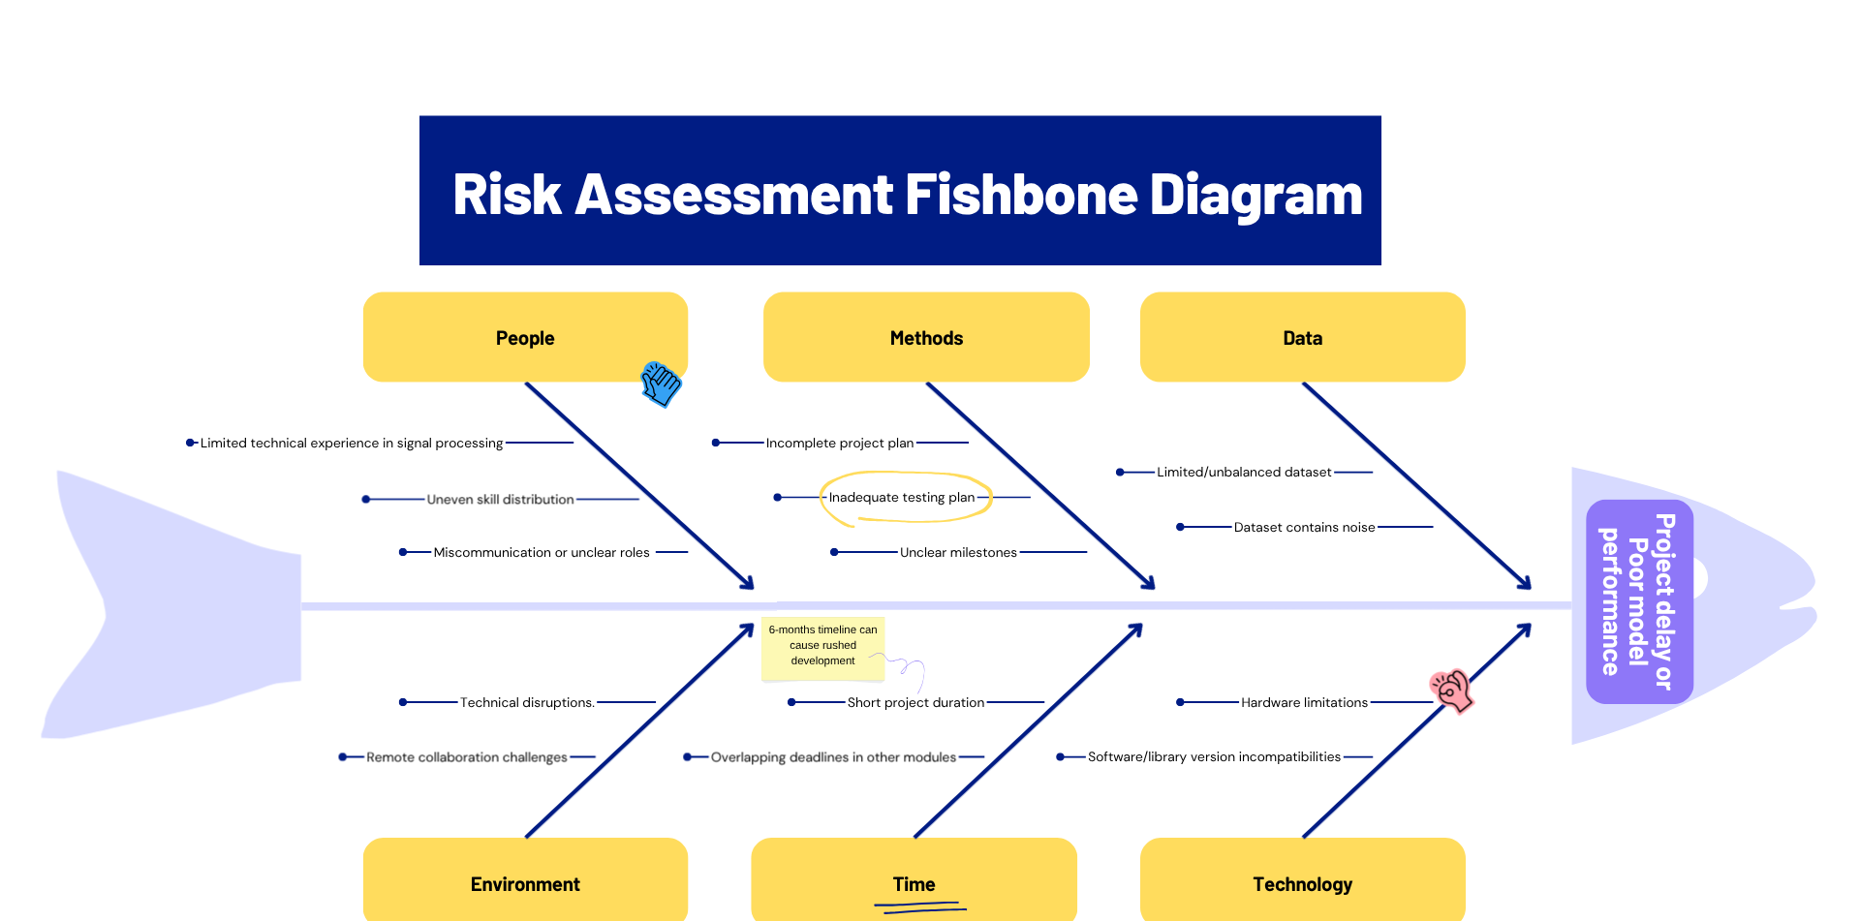
Risk assessment

